Slide 1
PROJECT TITLE Secure data hiding in images by using steganography
CAPSTONE PROJECT
Presented By:
Student Name : Lade Akhil
College Name & Department : Chaitanya Deemed to be University &CSE(AI&ML)

Slide 2
OUTLINE
Problem Statement
Technology used
Wow factor
End users
Result
Conclusion
Git-hub Link
Future scope

Slide 3
Problem Statement
With the rise in digital communication, ensuring secure transmission of sensitive data has become a critical challenge. Traditional encryption methods make data conspicuous, attracting potential attackers. Steganography offers a solution by hiding secret information within digital images, making the presence of hidden data undetectable to an observer. The problem lies in developing an efficient, secure, and imperceptible data hiding technique that maximizes embedding capacity while maintaining image quality and robustness against attacks like noise, compression, and steganalysis.

Slide 4
Technology used
For implementing secure data hiding in images using steganography, the following Python libraries are commonly used:
os – For The import os statement in Python is used to bring in the os module, which provides a way of using operating system-dependent functionality.
Install: pip install os(default)
OpenCV – For advanced image processing and manipulation.
Install: pip install opencv-python
we use python IDLE environment to execute the stego code.
1. Image Processing Technologies:
Least Significant Bit (LSB) Substitution – A common technique where secret data is embedded in the least significant bits of image pixels.2. Security & Cryptography Technologies:
AES (Advanced Encryption Standard) – Encrypts data before hiding it in the image.
Hashing Algorithms (SHA-256, MD5) – Used for integrity verification of hidden data

Slide 5
Wow factors
The "Secure Data Hiding in Images Using Steganography" project has several WOW factors that make it innovative and impactful:
🔥 1. Invisible Yet Secure Communication
Data is hidden within images without altering their visual quality, making it undetectable to the human eye.
Unlike encryption, which makes the presence of secret data obvious, steganography keeps it completely covert.
🔐 2. Dual-Layer Security (Encryption + Steganography)
AES/RSA Encryption before embedding ensures that even if the hidden data is extracted, it remains unreadable without the correct decryption key.
Hashing techniques (SHA-256) can be used for integrity verification, ensuring tamper-proof data transmission.
🎭 3. Resistance to Steganalysis & Attacks
Advanced DWT, DCT, or Hybrid Methods make it robust against compression, noise, and steganalysis techniques.

Slide 6
End users
The end users of the "Secure Data Hiding in Images Using Steganography" project depend on the application and industry. Here are some key potential users:
🔐 1. Cybersecurity Professionals & Ethical Hackers
Use steganography for covert communication in secure networks.
Employ it for data protection and preventing cyber espionage.
📱 2. Messaging & Communication Platforms
WhatsApp, Telegram, Signal, etc. can integrate steganography for invisible encrypted messaging.
Users can hide secret messages within shared images.
🏛 3. Government & Intelligence Agencies
Used for covert operations and secure intelligence sharing.
Helps in avoiding censorship and surveillance by adversaries.
💻 4. Digital Forensics & Law Enforcement
Helps in detecting hidden criminal activities (e.g., illegal data transfers).
Used for tracking hidden communications in images.

Slide 7
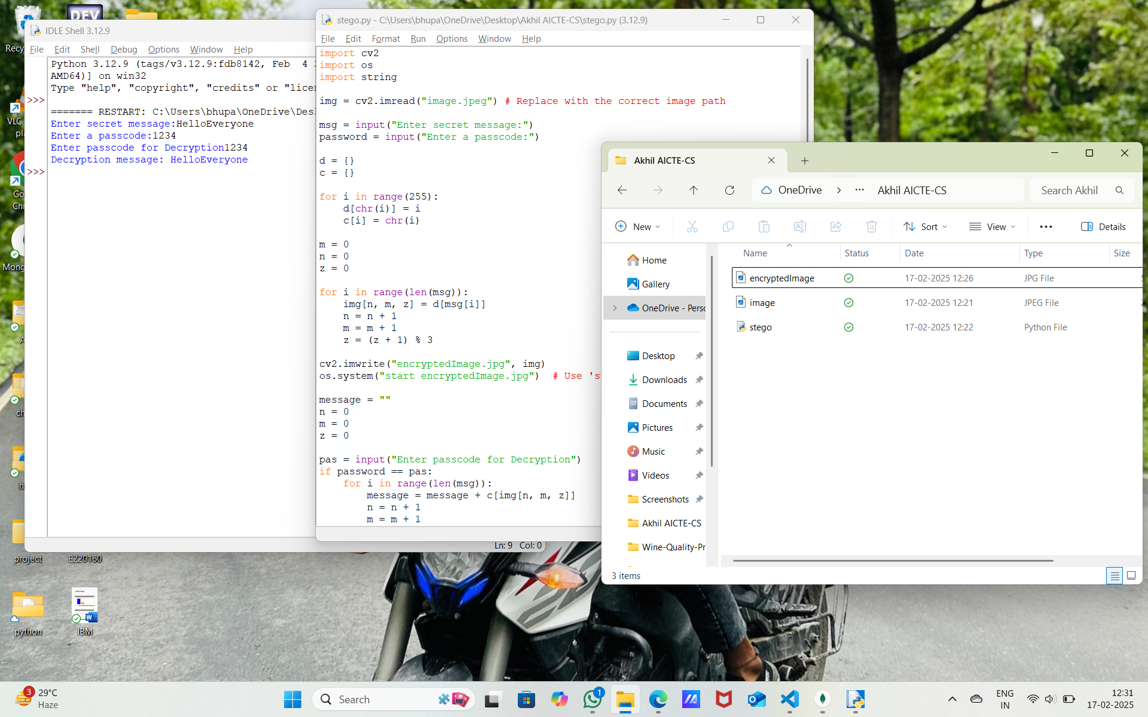
Results

Slide 8
Conclusion
The "Secure Data Hiding in Images Using Steganography" project provides an innovative and effective approach to covert communication by embedding secret information within digital images. Unlike traditional encryption, which makes the presence of hidden data obvious, steganography ensures that confidential information remains undetectable to unauthorized users. By integrating encryption techniques (AES/RSA), advanced embedding methods (LSB, DWT, DCT), and AI-driven steganalysis resistance, the system enhances both security and robustness against attacks like noise, compression, and steganalysis.
This technology has wide-ranging applications in cybersecurity, digital watermarking, secure messaging, intelligence operations, financial transactions, and healthcare. The implementation of high-capacity, imperceptible, and resilient data hiding techniques makes this project highly valuable in today’s data-driven world. Future enhancements may include AI-based adaptive steganography, blockchain for secure verification, and real-time steganalysis detection, further strengthening the security and usability of the system.

Slide 9
GitHub Link
https://github.com/akill10/Aicte-CyberSecurity.git

Slide 10
Future scope(optional)
Future Scope of Secure Data Hiding in Images Using Steganography 🚀
As digital security threats evolve, steganography will continue to play a crucial role in covert communication and data protection. The future scope of this project includes advancements in robustness, security, and real-world applications across various domains.
🔥 1. AI & Machine Learning for Adaptive Steganography
Implement Deep Learning (CNNs, GANs) to enhance undetectability by generating stego-images that closely resemble natural images.
Use AI-based steganalysis to counteract attacks and dynamically adjust embedding strategies.
🔐 2. Blockchain Integration for Secure Verification
Blockchain-based watermarking to verify the authenticity of hidden data and prevent tampering.
Decentralized steganographic communication channels for secure, untraceable transactions.
🏦 3. Enhanced Security for Financial & Government Sectors
Secure bank transactions where sensitive data (e.g., account details) is hidden within images.
Government agencies can secure classified communications without raising suspicion.

Slide 11
THANK YOU

